Slide 1
1. LLM basics
VIB AI Summer School 2025
Francesco Carli

Slide 2
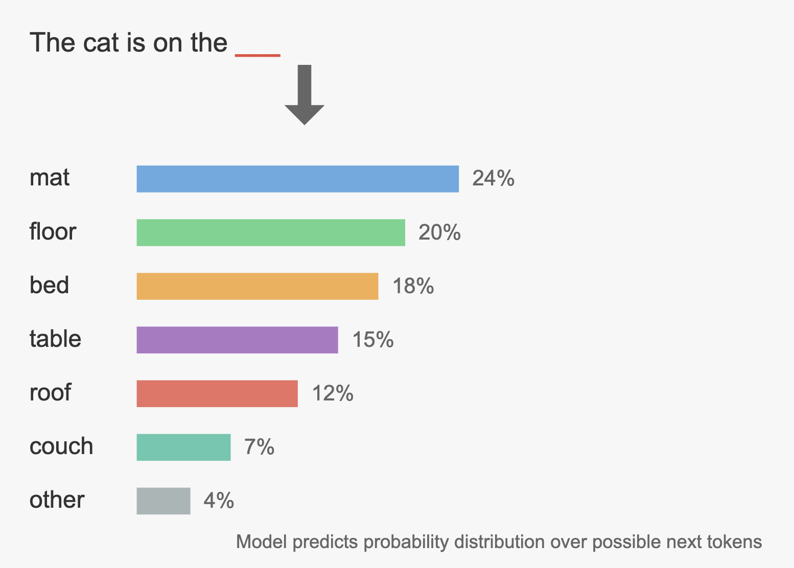

Next token predicton
Generated with Claude Opus 4

Slide 3
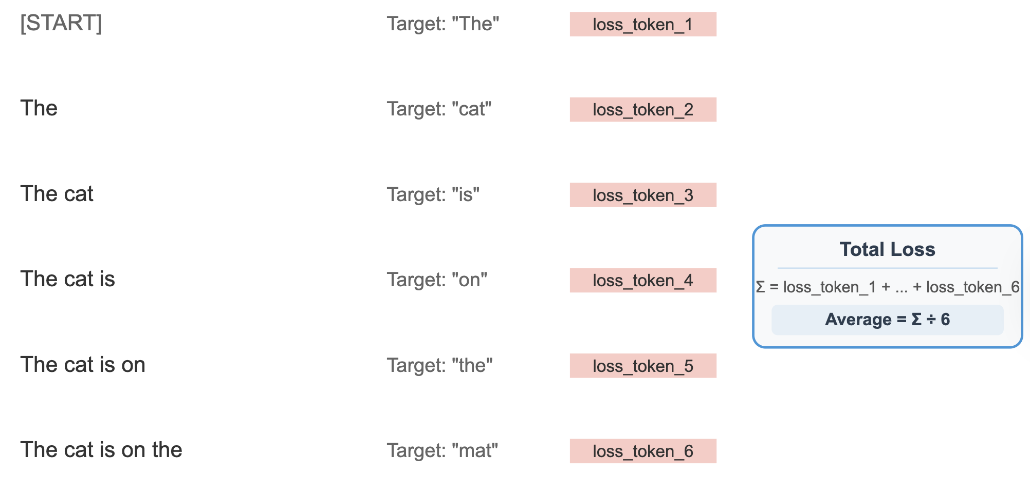
Pre-training: a simple loss function
Generated with Claude Opus 4

Slide 4

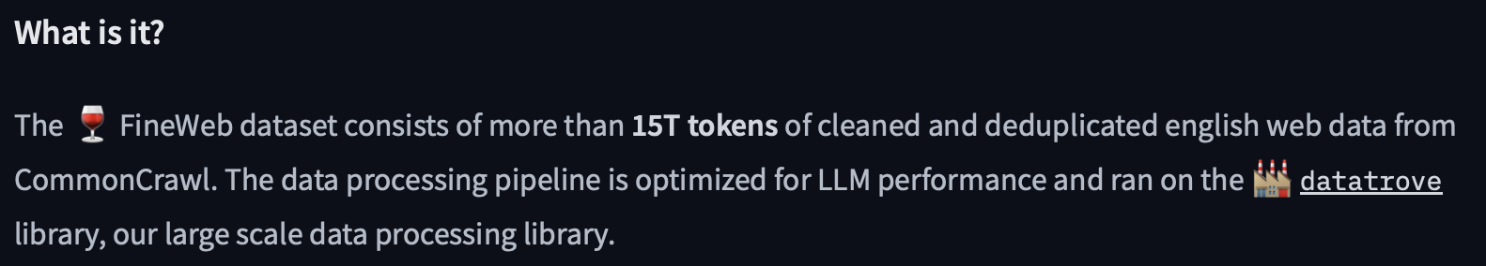
Scrape the whole internet and train on it

Slide 5

Scrape the whole internet and train on it

Slide 6

Scrape the whole internet and train on it

Slide 7

Scrape the whole internet and train on it

Slide 8
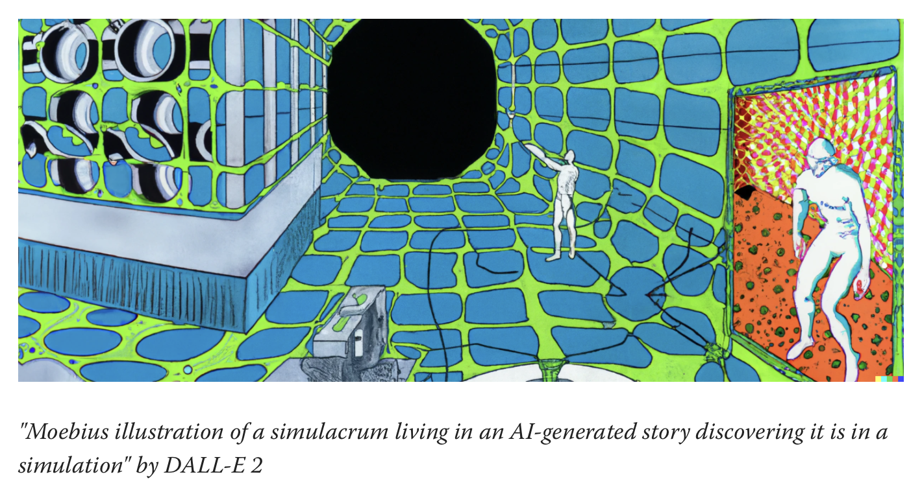
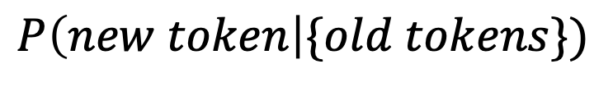
Is “just a simulator”
$$P\left(new token\right|\{old tokens\})$$
https://www.lesswrong.com/posts/vJFdjigzmcXMhNTsx/

Slide 9

Understanding hallucinations

Slide 10
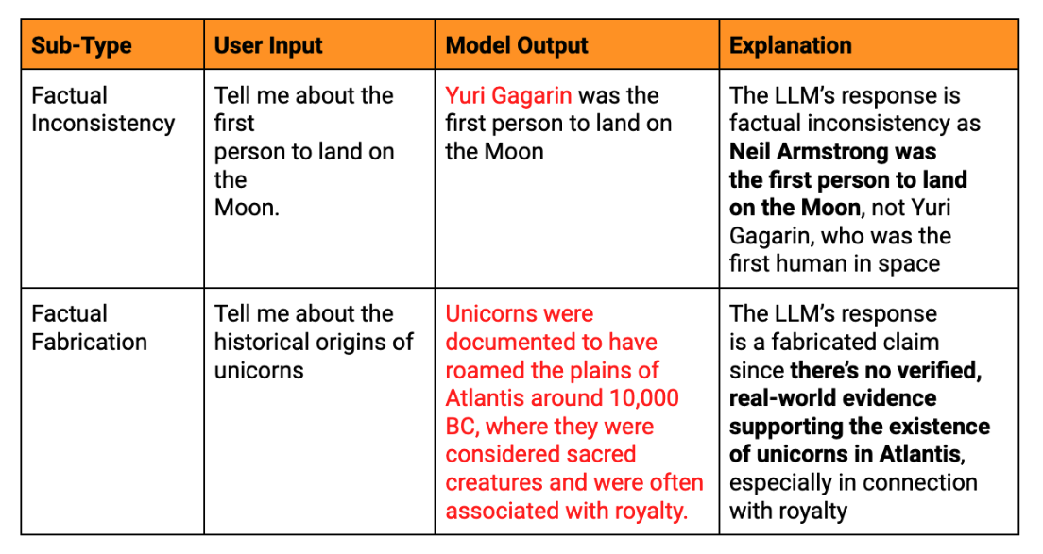
Understanding hallucinations
https://www.lakera.ai/blog/guide-to-hallucinations-in-large-language-models

Slide 11
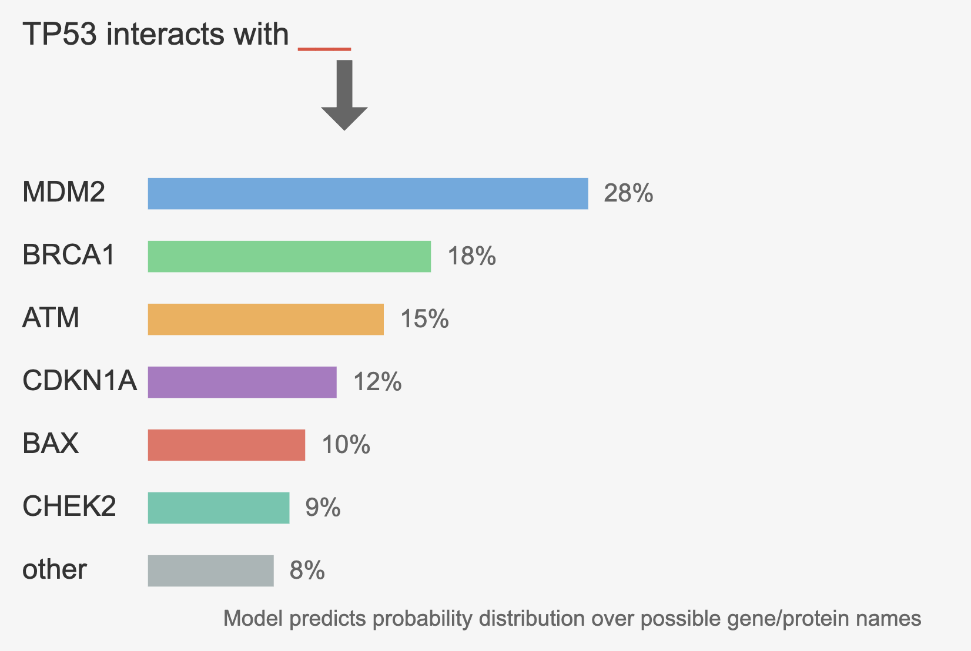
Understanding hallucinations
Generated with Claude Opus 4

Slide 12
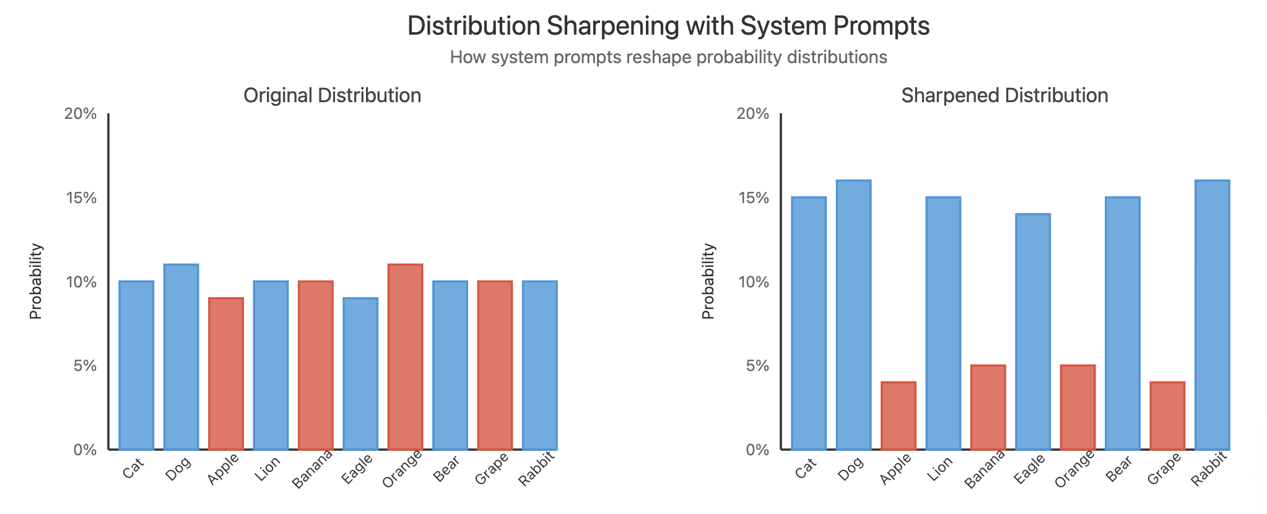
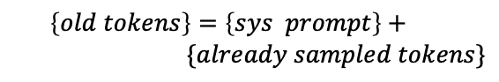
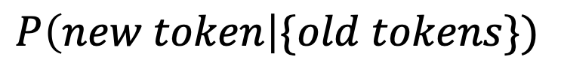
The role of the system prompt
‘We are talking about animals”
$$P\left(new token\right|\{old tokens\})$$
$$\left\{old tokens\right\}=\left\{sys prompt\right\}+$$
$$\{already sampled tokens\}$$
Generated with Claude Opus 4

Slide 13
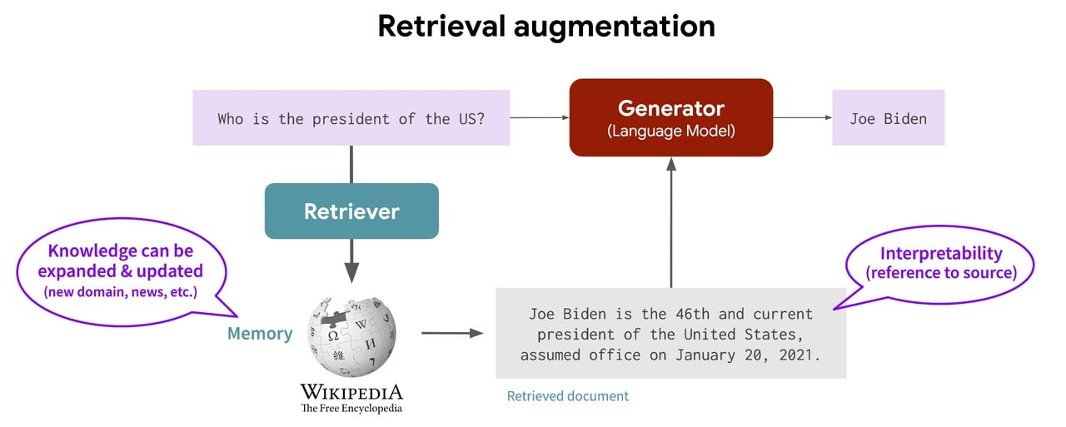
Likewise for RAG
https://transformer-circuits.pub/2022/in-context-learning-and-induction-heads/index.html#copying-literal-text

Slide 14
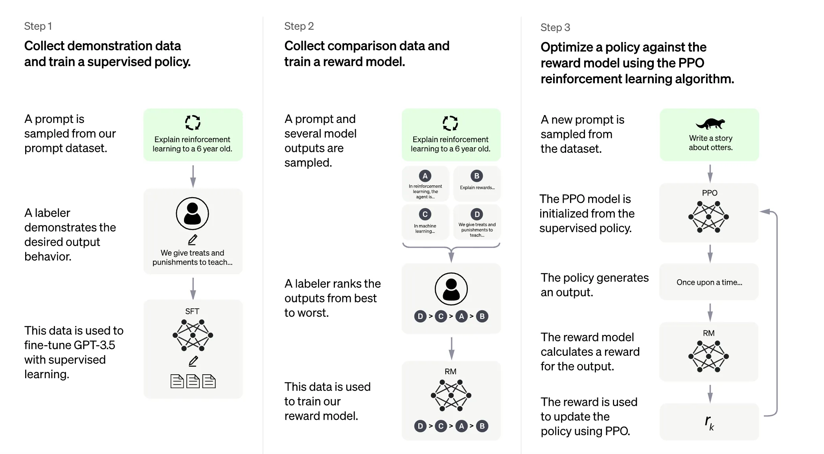
Instruction tuning: reinforcement learning from human feedback (RLHF)

Slide 15
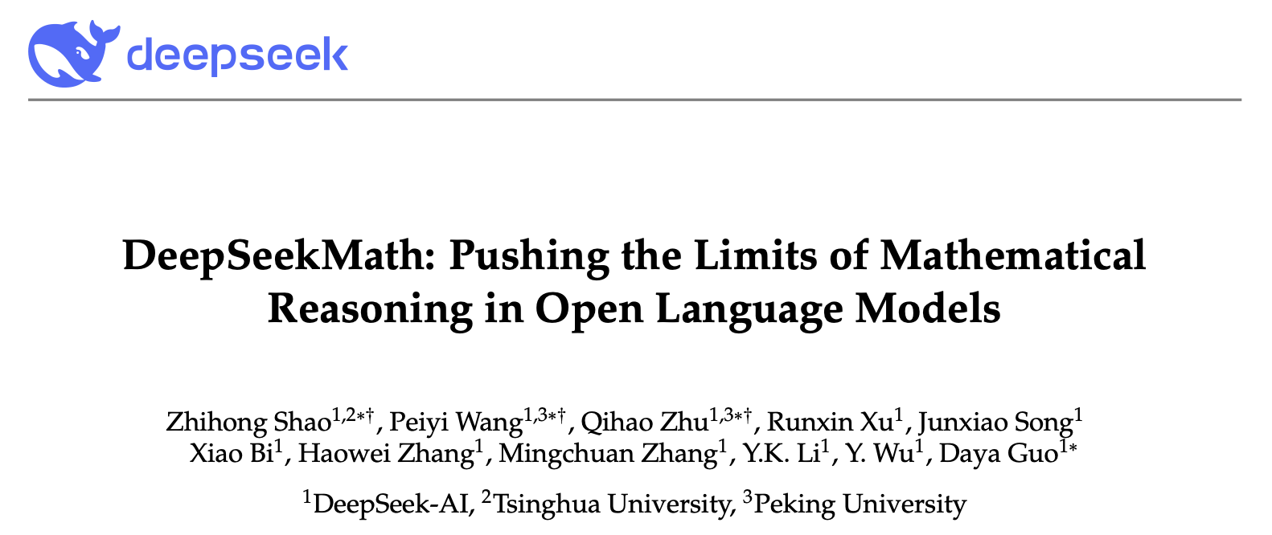
Post training: reinforcement learning with verifiable rewards (RLVR)

Slide 16
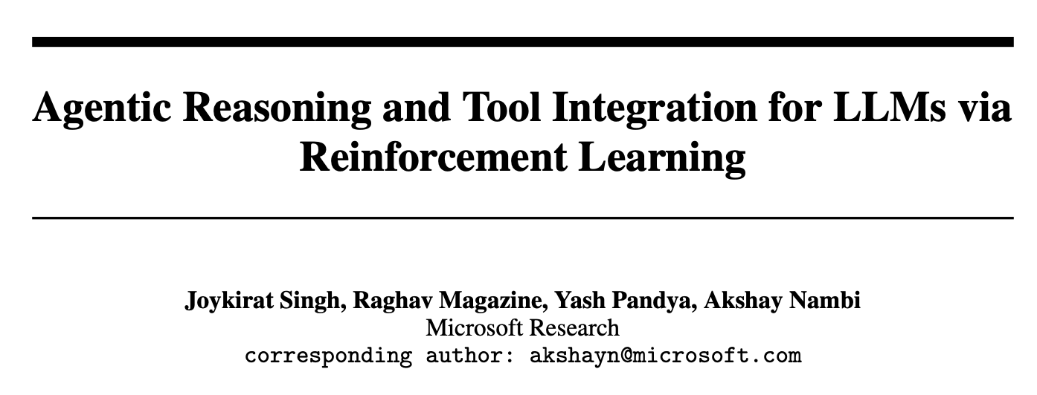
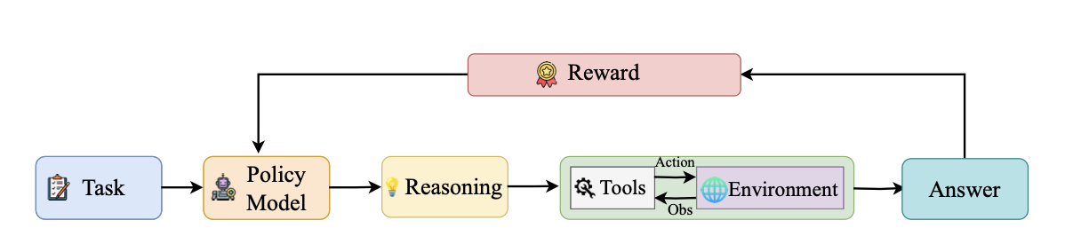
Post training: reinforcement learning with verifiable rewards (RLVR)

Slide 17
Recap of the training steps
Pre-training: raw next token prediction;
Instruction tuning (RLHF): alignment with human preferences;
Post-training: extension to specific thinking/agentic behaviors

Slide 18
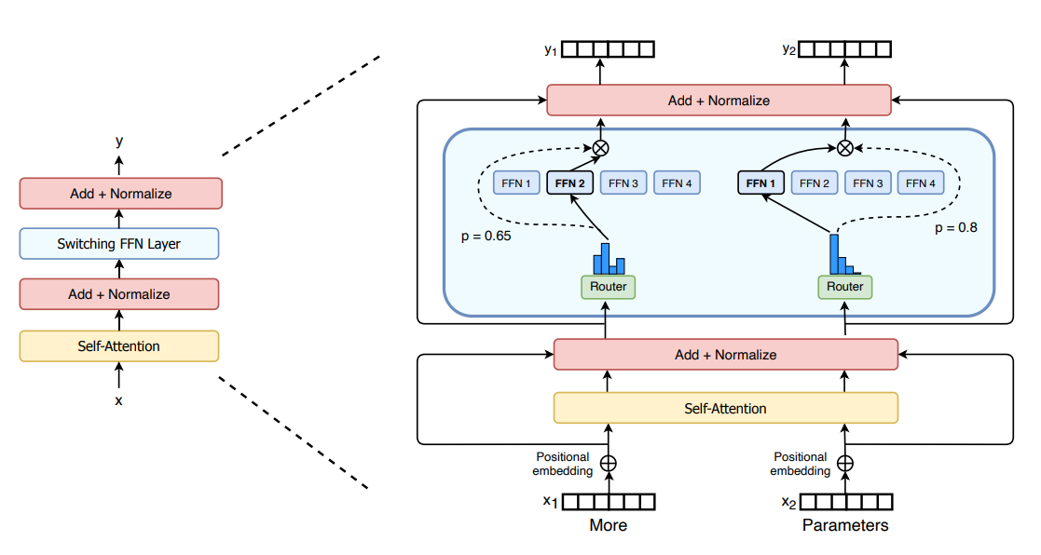
Mixture of Experts
Key points:
Have faster inference compared to a model with the same number of parameters;
Require high VRAM as all experts are loaded in memory
Face many challenges in fine-tuning
https://huggingface.co/blog/moe

Slide 19
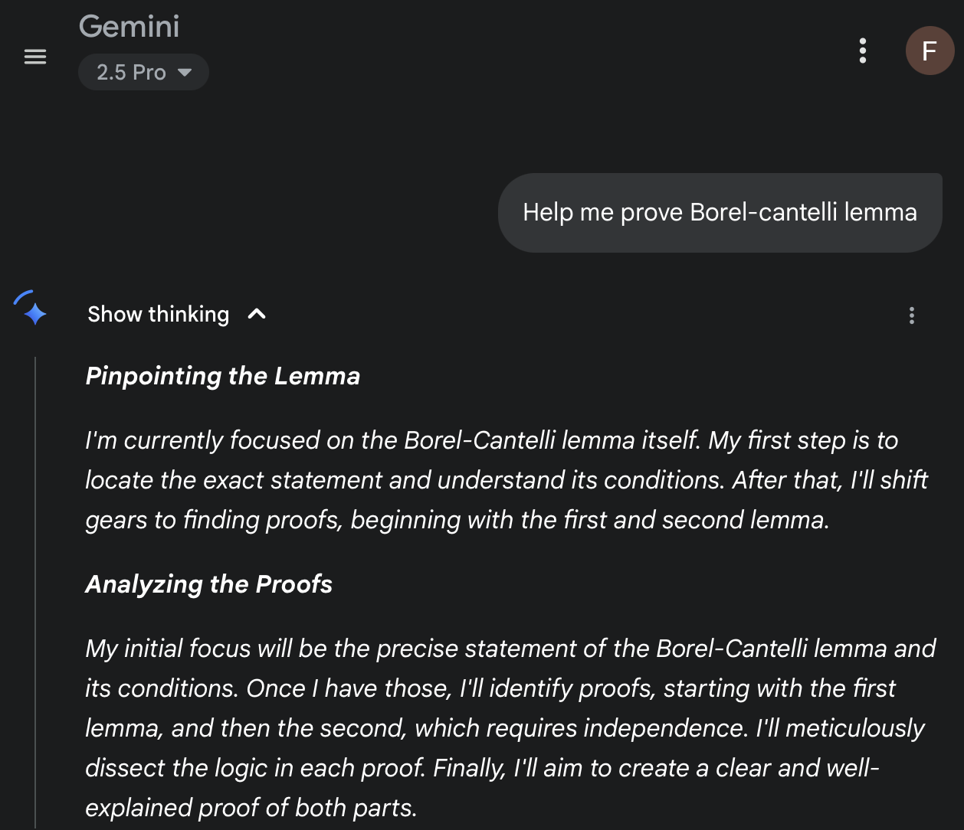
Thinking models vs. standard models
Reasoning models produce intermediate “chain-of-thought” traces; regular models output only final answers.
Thinking models are trained on or fine‑tuned with step‑by‑step reasoning examples; regular models are trained on direct input–output pairs only
Reasoning models perform better on multi-step tasks , such as logic, math, programming, and planning; regular models struggle or approximate.
They often require more compute and generate longer outputs, due to reasoning steps; regular models are faster and leaner.
Nice resource: https://magazine.sebastianraschka.com/p/understanding-reasoning-llms

Slide 20

Where to find models

Slide 21










Two big families
“Open” models
Llama3 (meta.ai)
Qwen3 (alibaba)
GLM 4.5 (z.ai)
DeepSeek 3.1 (DeepSeek)
Kimi-K2 (moonshot.ai)
Mistral Small 3.1 (Mistral.AI)
Commercial models
GPT5 (OpenAI)
Gemini (Google DeepMind)
Claude 4 (anthropicAI)
Grok 4 (xAI)

Slide 22
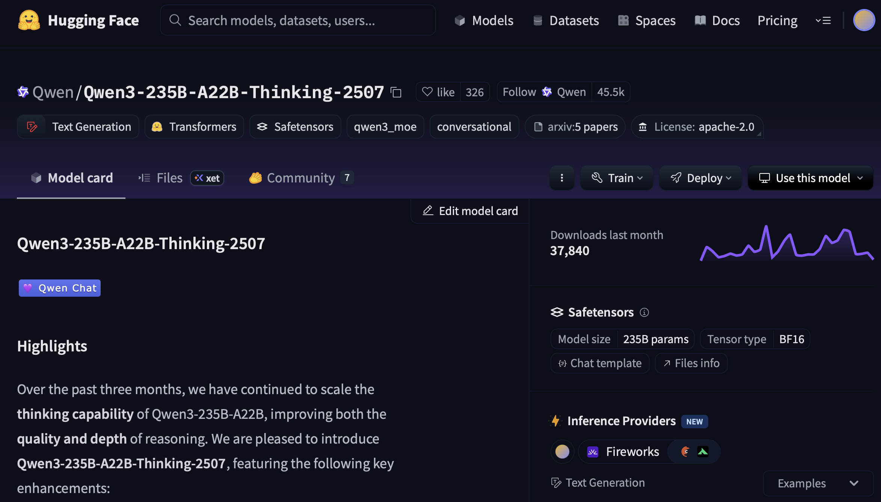
Where to find open models
https://huggingface.co

Slide 23
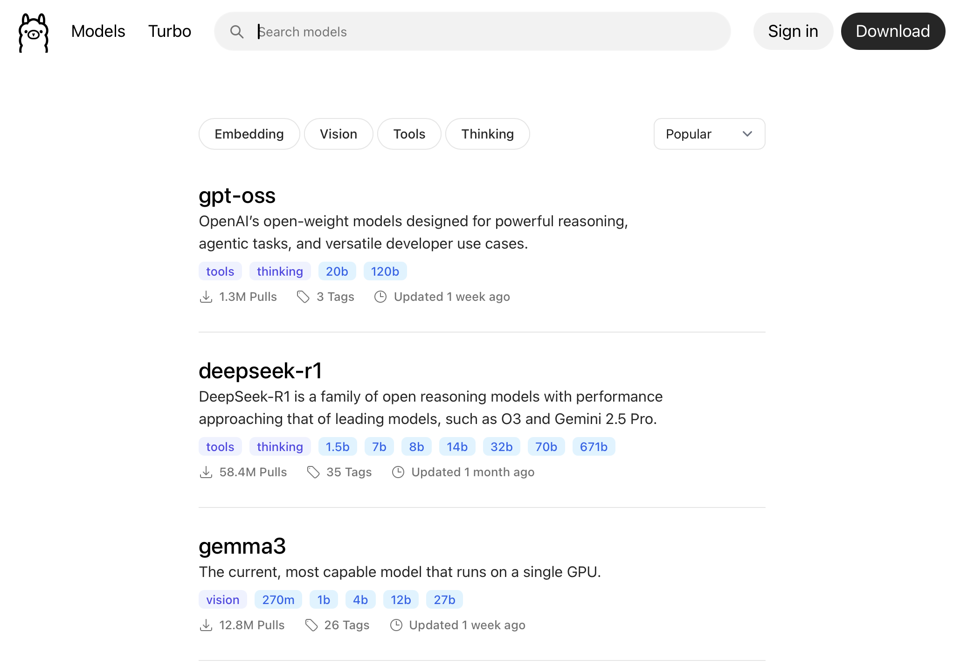

Where to find open models
https://ollama.com

Slide 24
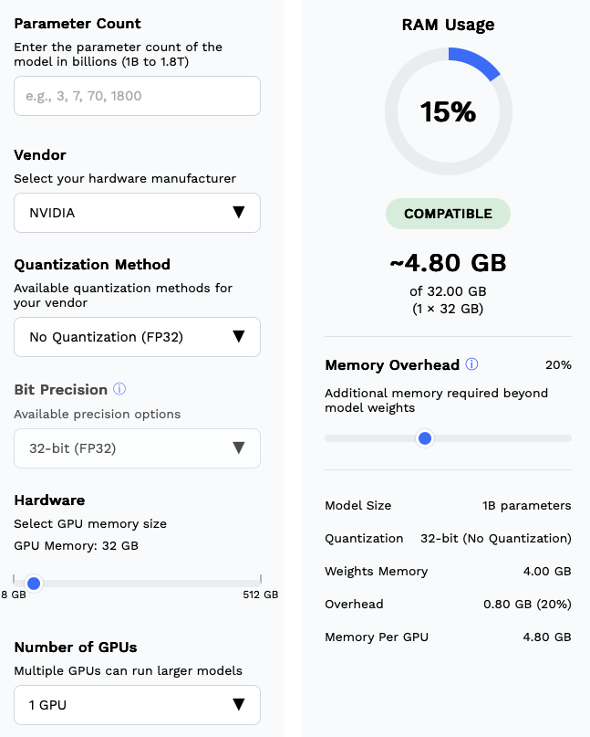
Size calculator
https://research.aimultiple.com/self-hosted-llm/

Slide 25
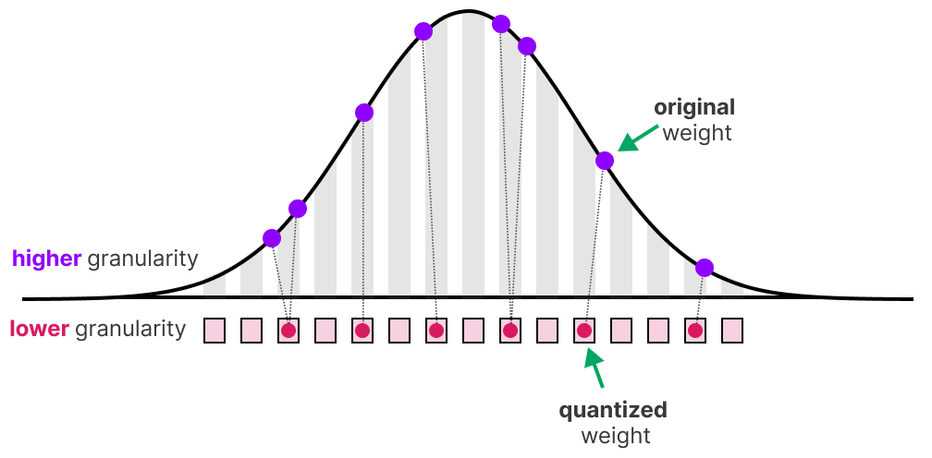
Quantization
https://newsletter.maartengrootendorst.com/p/a-visual-guide-to-quantization

Slide 26

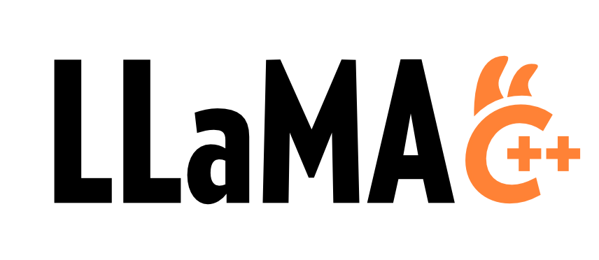

Other libraries for open models
https://github.com/vllm-project/vllm
https://github.com/ggml-org/llama.cpp
https://github.com/sgl-project/sglang

Slide 27

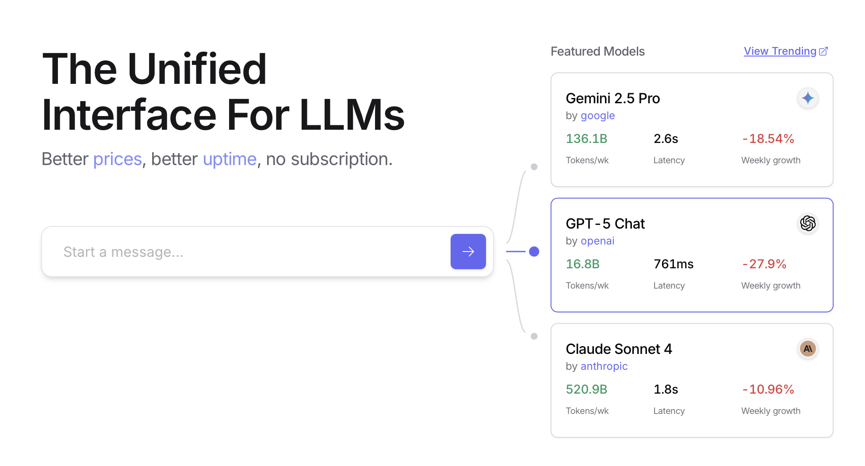
Where to find closed models
https://openrouter.ai

